Slide 1
EENG 385 Total Harmonic Distortion
Notes:
Usually the <title of the lab> is what will be called the “System” through the rest of this document

Slide 2

Taking Lab Assistant Applications
The EENG 385 lab assistant position pays 4-hours a week. Responsibilities of a lab assistant include:
Attending a 4-hour EE Lab Assistant training event at the start of the term,
Working with another undergraduate lab assistant to run the lab. This includes helping students:
Troubleshoot circuits,
Interpreting lab instructions,
Configuring test and measurement equipment
Working with the software
Introducing the lab at the start of the class,
Grading the weekly lab deliverables and entering the grades in Canvas,
Spending 30 minutes reviewing the lab materials,
Meeting 30 minutes a week with the course instructor to review the lab.
This is a great way to both learn the materials and develop teamwork, leadership
and communication skills. There are some other perks that I am working on, so stand by.

Slide 3
Lab Objectives
The objective of this lab is to measure the total harmonic distortion (THD) of the audio amplifier using the FFT feature of the oscilloscope.

Slide 4
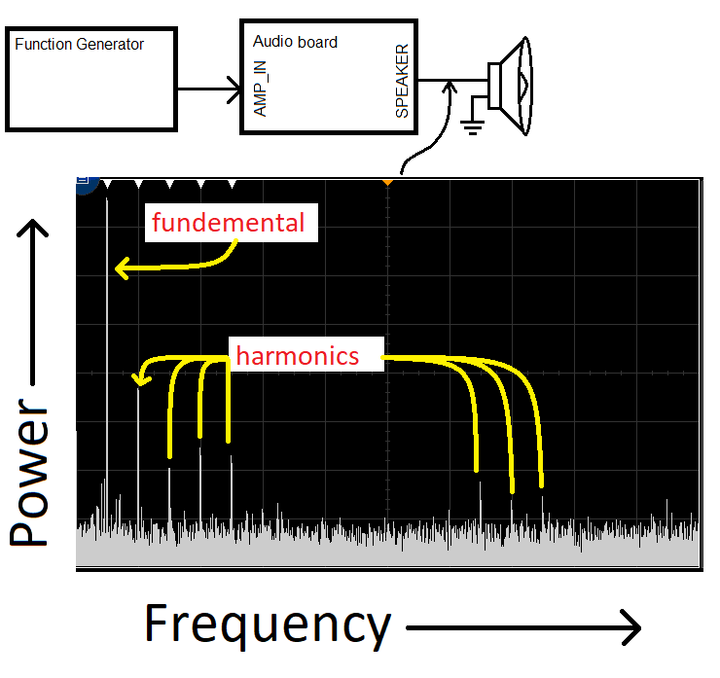
Theory
Fundamental
Frequency of input
Harmonics
Integer multiple of fundamental
Oscope FFT
X axis is frequency
Y axis is power @ frequency
Perfect amplifier
All power in fundamental
Notes:
Replace <System> with the name of the

Slide 5
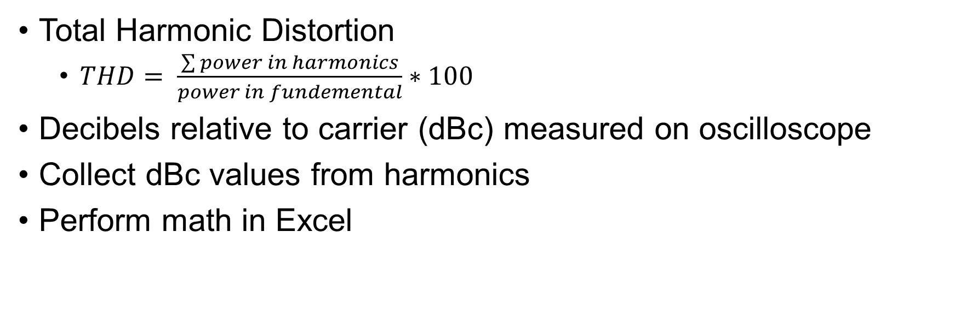
Theory
Total Harmonic Distortion
$THD= \frac{\sum{power in harmonics}}{power in fundemental}∗100$
Decibels relative to carrier (dBc) measured on oscilloscope
Collect dBc values from harmonics
Perform math in Excel
Notes:
Replace <System> with the name of the

Slide 6
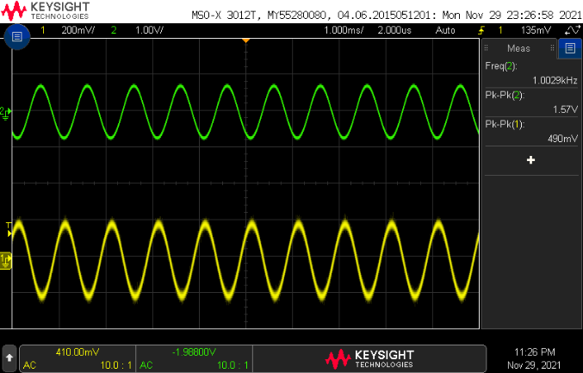
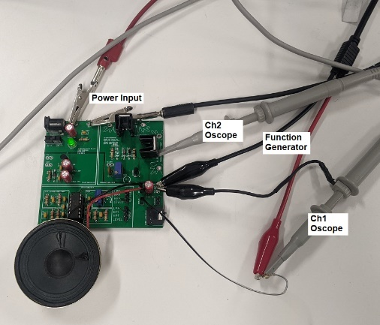
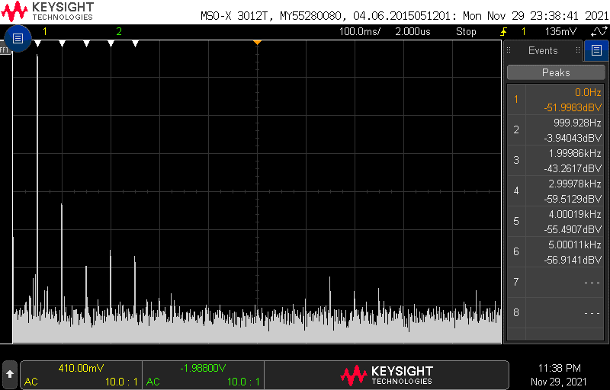
Test
Setup Time Domain
Freq Domain
Notes:
Replace <System> with the name of the

Slide 7
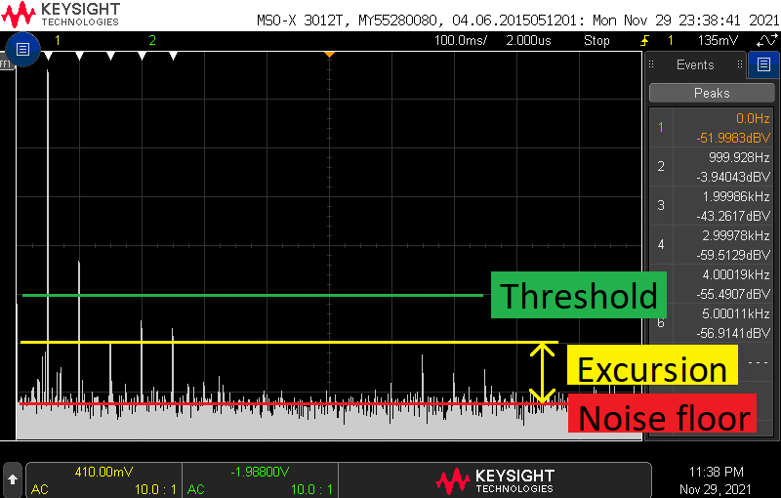
Test
Search function automates FFT measurement
Noise floor = average lowest
Threshold = absolute
Excursion = relative to floor
Peaks = Threshold OR Excursion
Tips
Use Averaged Value improve noise floor
Use Run/Stop
Notes:
Replace <System> with the name of the

Slide 8
Turn In
Table 1
Complete THD graph
X axis = Vpp
Y axis = THD
For several frequencies

